Slide 1
Ayen: Pothole Detection System Using Deep Learning Techniques
Lina Ali Alhuri

Slide 2
Abstract
Detecting potholes manually is a time and labor-consuming process. Early fast detection benefits the municipality
This project takes advantage of the available data to detect potholes in the fastest most accurate way. Reducing the overall cost of the discovery of road defects.
The resultant product of this work will be a system called Ayen used to detect potholes with the help of deep learning techniques

Slide 3
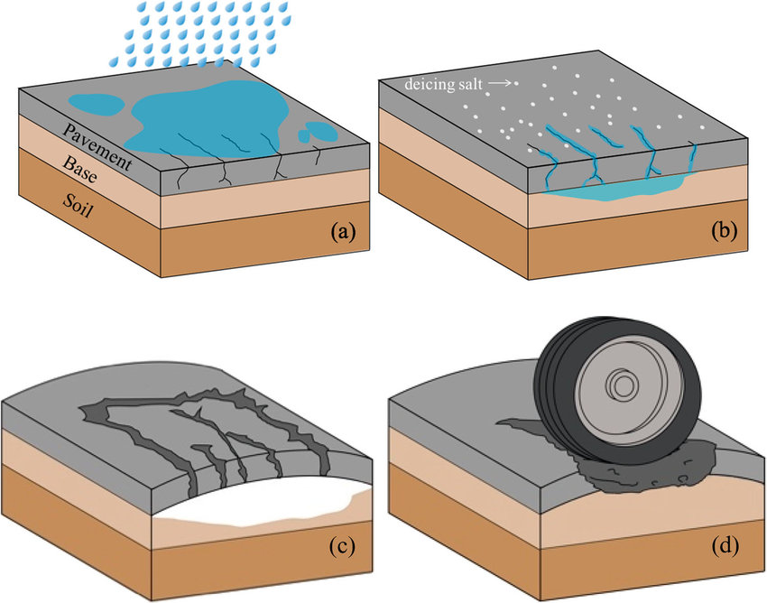
What is a pothole and What does it affect?
A pothole is a bowl-like hole in the surface of the road
It is caused by liquid slipping deep in the road cracks. Weakening its internal structure, with the weather cycling between hot and cold. The trapped liquid in the roads’ cracks expands and contract. Combining that with the heavyweight of the cars during traffic potholes will form as

Slide 4
Problem definition
The traditional process of detecting pothole is time-consuming and labor intensive.
There are millions kilo meters of roads to be scanned and existence of
Pothole will cause flat tires, cracked wheels, and damaged suspensions.
Motivation
This work helps facilitate the work of the municipality with the power of computer vision. Making our system the eye for municipality offices. Providing a fast and free-cost solution for potholes detection.

Slide 5
Project objectives
To identify the issues of the pothole's detection systems.
To study the solutions for the identified issue.
To present a deep learning model predicts the existence of potholes in images.
To integrate the best model into an interface.

Slide 6
Project scope
Our final deliverable system detect road potholes through images of the city’s roads. Saving time and effort for the municipality’s worker. Guaranteeing a fast and accurate detection of potholes before they escalate and be costly to repair.

Slide 7
Background and related work

Slide 8
Background
Potholes Detection Approces
vibration-based
3D reconstruction-based
2D image vision-based methods

Slide 9
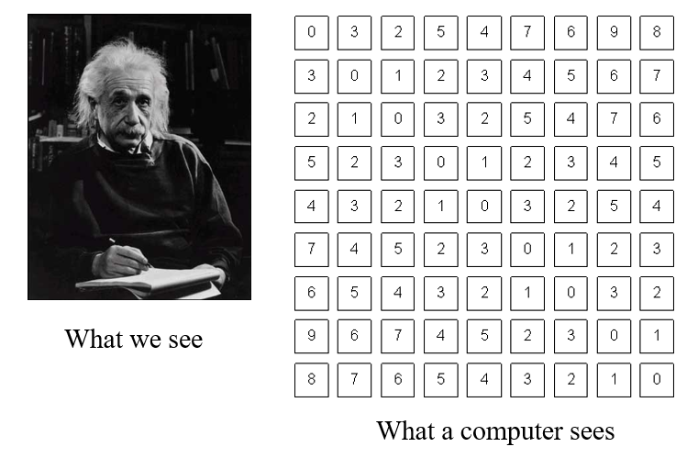
Computer vision
It is a multidisciplinary field that combines artificial intelligence and machine learning. Utilizing the power of learning algorithms and a good understating of image geometry as explained by Forsyth et.aa

Slide 10
Paper | Data | Preprocessing | Feature extraction | Rate of success
A Deep Learning-Based Approach for Road Pothole Detection in Timor Leste. | Collection of datasets | Resizing into 200 x 200 pixels Cropping the image | The convolutional and pooling layers work as a feature extractor. | CNN 99.80% SVM 88.20%
A Deep Learning Approach for Street Pothole Detection. | Stellenbosch University dataset. | Grayscale conversion Edge Detection Dilation Erosion Thresholding Closing. | HOG | Faster R-CNN 74% HOG 27% SSD 80% YOLO V3 82%
Pothole and Bump detection using Convolution Neural Networks. | Our dataset is made up of data published online. | Cropping the image Resizing to 224X224 Pixel to input to a pretrained network. | The convolutional and pooling layers | pretrained ResNet-50+ YOLO 88.9%
Our work | Available dataset | Grayscale conversion Resizing the images | The convolutional and pooling layers | CNN, ResNet50
Relationship between our work and related-work
Our work compare the results of simple CNN and ResNet50 classifiers.
CNN does not require feature extraction techniques before training. As mentioned in related work
ResNet50 will guarantee a fast and accurate prediction for our system
We will be excluding the use of YOLO V3 because the only feature it contains is speed compared to other algorithms.
SDD provided great results in the related work. However, it is slow to train on.

Slide 11
System analysis and methodology

Slide 12
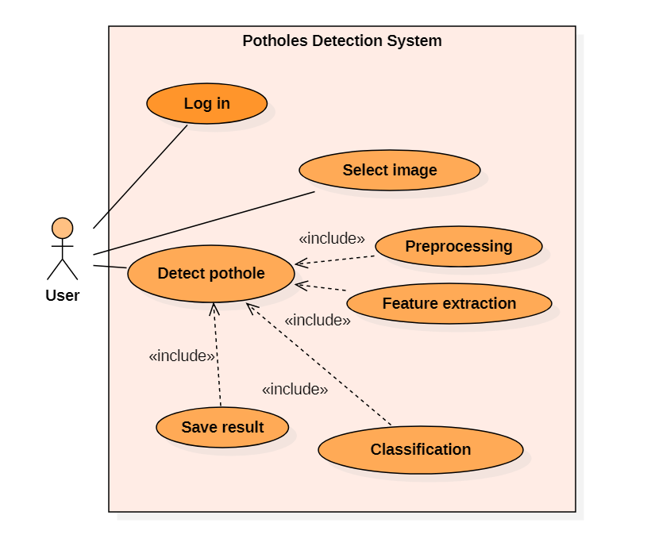
Use Case

Slide 13
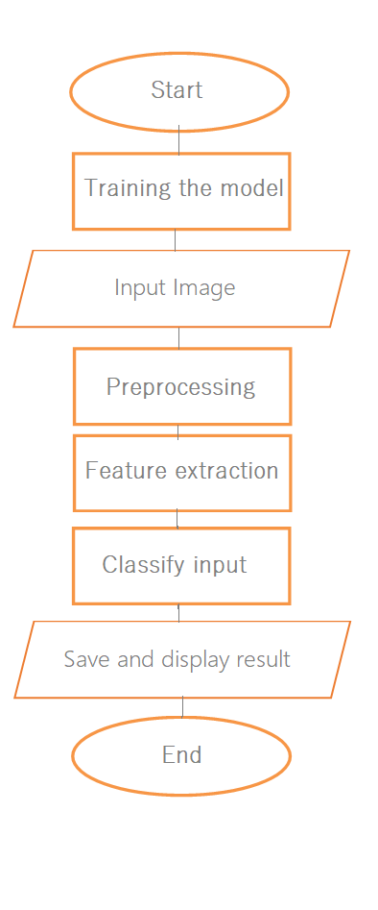
Flow Chart

Slide 14
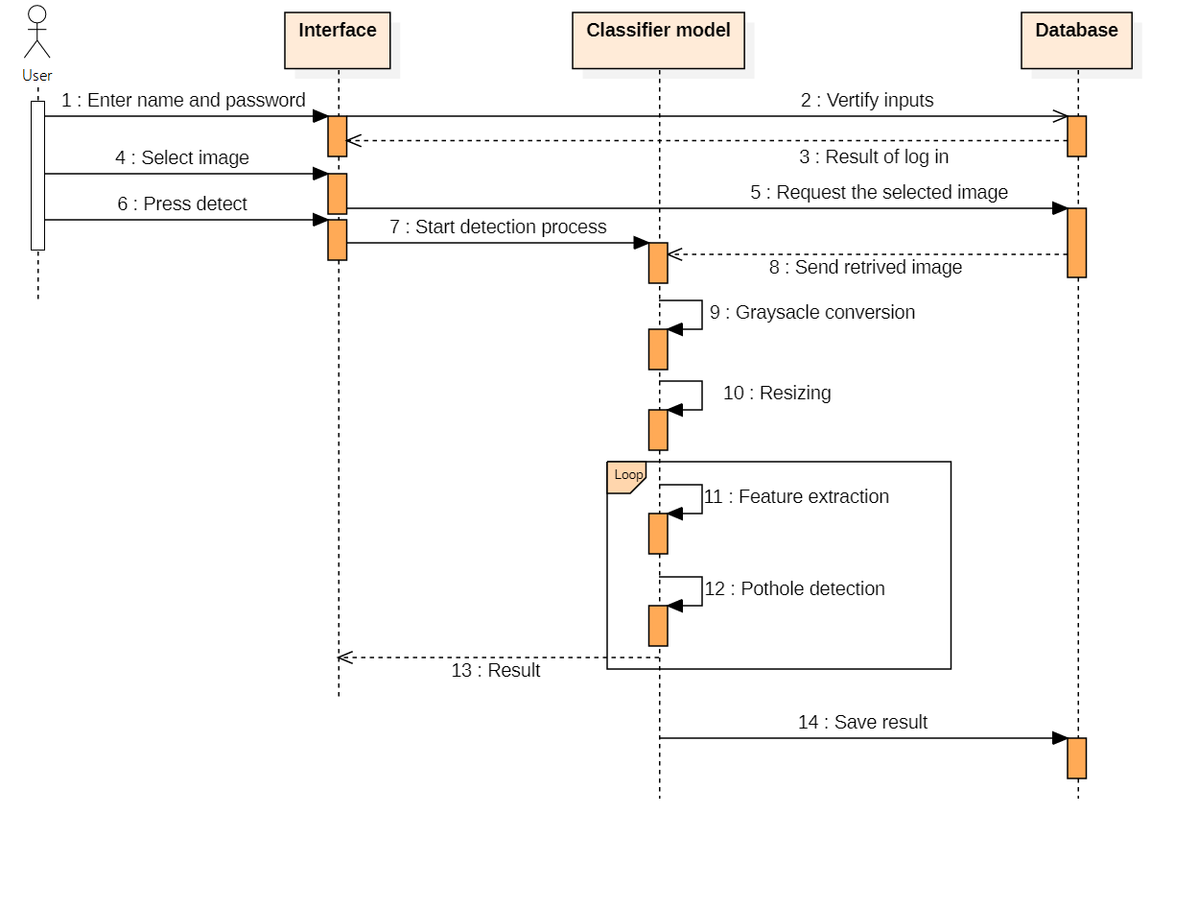
Sequence diagram

Slide 15
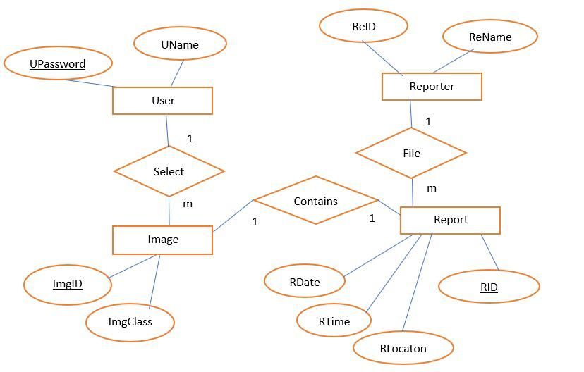
Entity Relation diagram

Slide 16
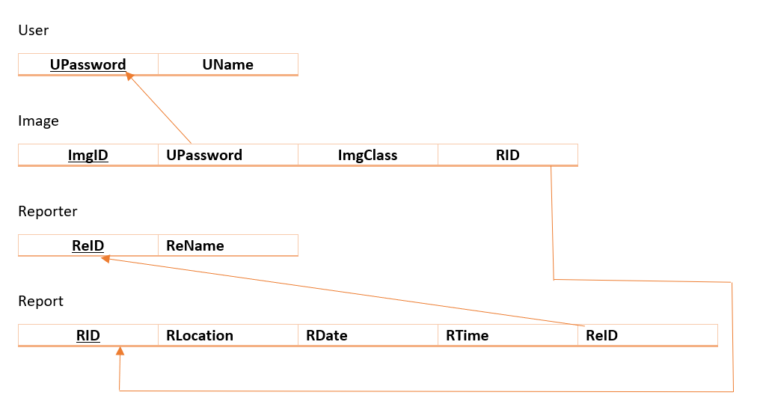
Schema Diagram

Slide 17

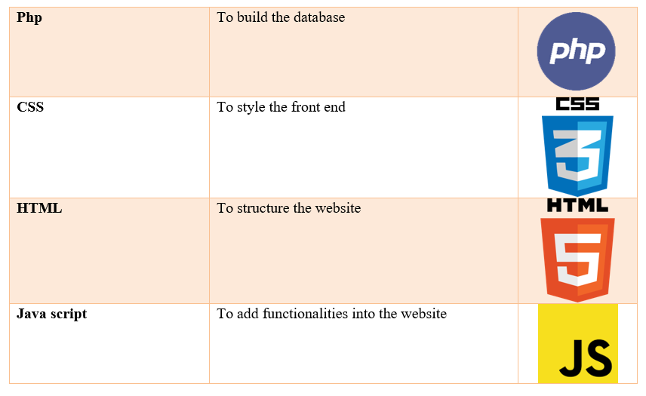
software requirements

Slide 18
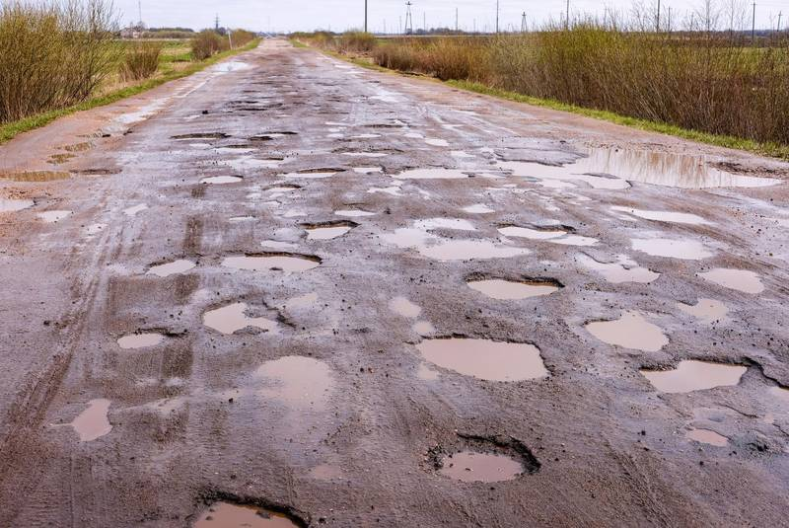
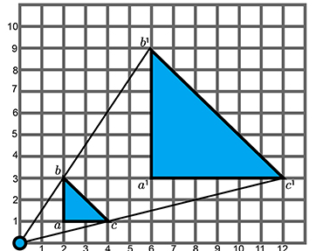
Preprocessing
Grayscale conversion
Resizing

Slide 19
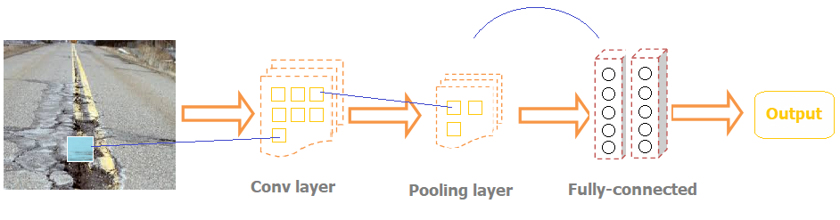
CNN explained

Slide 20
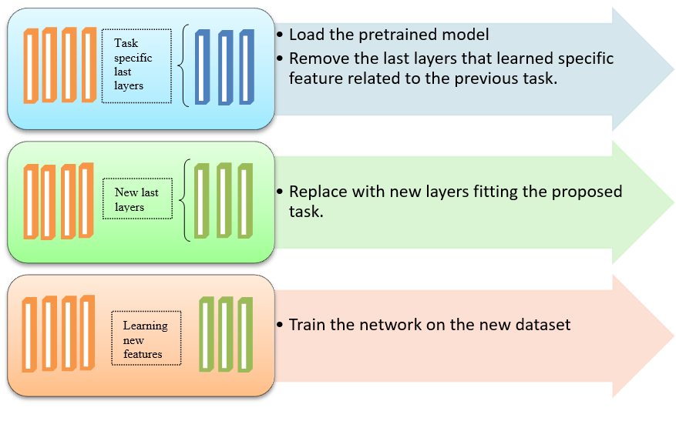
ResNet-50

Slide 21

Evaluation
$Accuracy= \frac{Number of correct detections}{Total number of input images}$

Slide 22
System Design

Slide 23
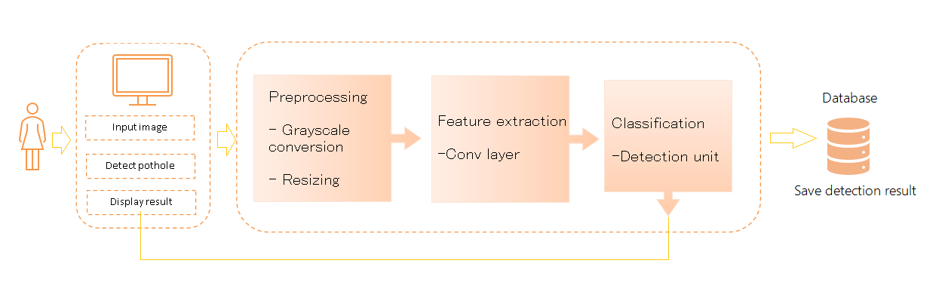
Architectural design

Slide 24
Developed Algorithms
Grayscale conversion
For each pixel
Green is equal to the pixel.Green
Red is equal to the pixel.Red
Blue is equal to the pixel.Blue
Gray= (Green*0.587 + Red*0.299 +Blue*0.114)
pixel.Green= Gray
pixel.Red= Gray
pixel.Blue= Gray

Slide 25
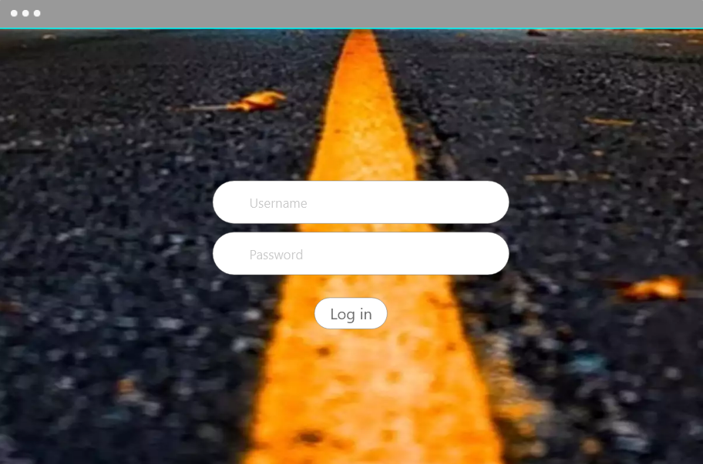
User interface

Slide 26
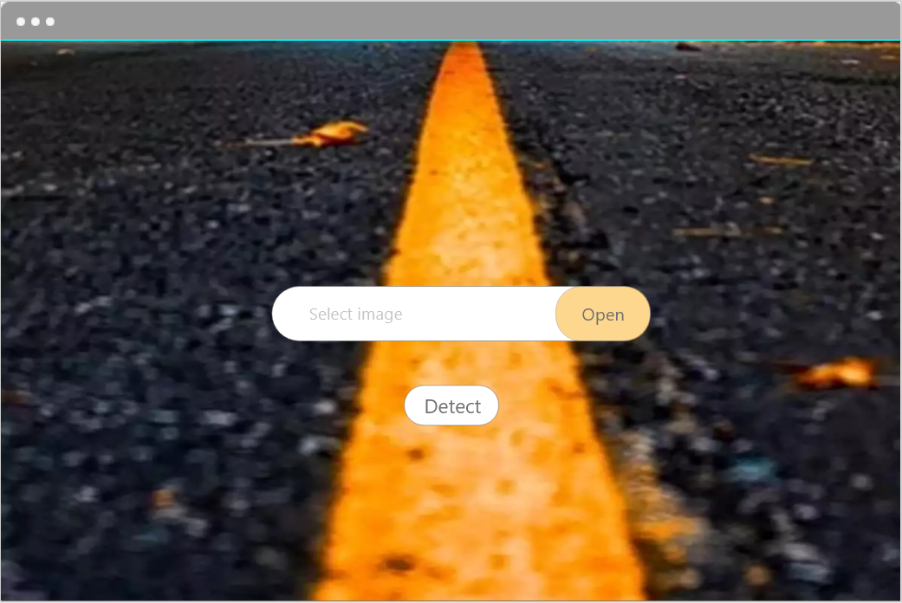
User interface

Slide 27
Conclusion

Slide 28
To conclude…
This project is mainly research-based.
This project propose a model that detects potholes out of an input image.
Experimenting with simple learning algorithms such as CNN and Transfer learning models such as ResNet50.
Integrating the model it into a simple interface
The main user of the model is the municipality. Where they can use the system to filter picture reports sent to the municipality of potholes. Eliminating fake reports.

Slide 29
Achieved Goals
Objective | Achievements
To identify the issues of the pothole's detection systems. | Done
To study the solutions for the identified issue. | Done
To present a deep learning model predicts the existence of potholes in images. | Second semester
To integrate the best model into an interface that can be used by the municipality. | Second semester

Slide 30
Limitation & Future work
One of the limitations of this work is that it only detects potholes from images.
For future work:
Detect potholes out of a real-time video. Targeting car drivers as the main user
Installing the system on a hardware device that contains a camera capable of recording the street and sending real-time snaps directly to the model to detect potholes and warn drivers of up-close road defects.

Slide 31
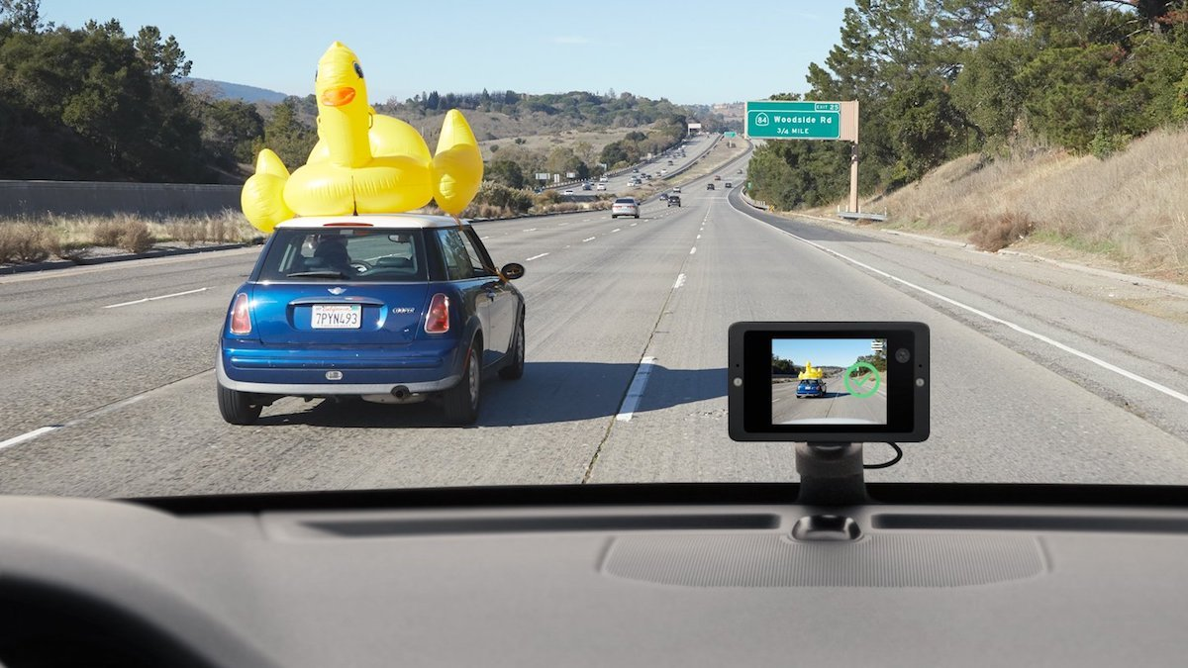

Slide 32
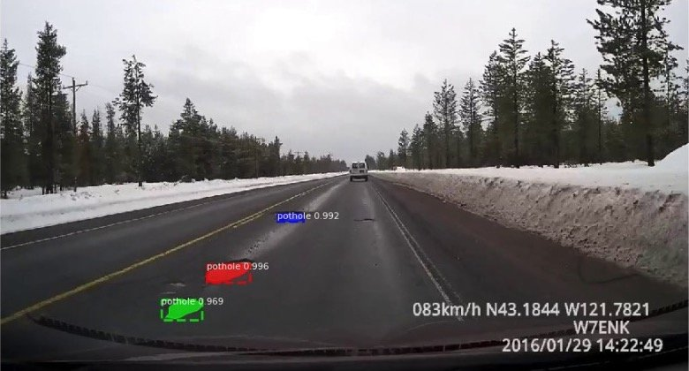

Slide 33
Thank you for listening

